Slide 1
Rockbuster Stealth LLC: Data-Driven Strategy for Online Video Rental Success
Luis Gil
22/05/2024

Slide 2
Welcome to the presentation on Rockbuster Stealth LLC's strategic initiative in response to evolving market dynamics. Rockbuster Stealth, a renowned movie rental company with a global presence, has historically operated through physical store locations worldwide. However, in the face of formidable competition from streaming giants like Netflix and Amazon Prime, Rockbuster Stealth is at a pivotal juncture. Recognizing the need to adapt to changing consumer preferences and market trends, the management team is charting a new course. Leveraging its extensive library of movie licenses, Rockbuster Stealth is poised to launch an innovative online video rental service. This strategic move aims to not only retain relevance in a fiercely competitive landscape but also to meet the evolving needs of its discerning customer base. Join us as we delve into the insights gleaned from Rockbuster Stealth's data, offering valuable perspectives on this transformative journey.
Introduction

Slide 3
● Which movies contributed the most/least to revenue gain? ● What was the average rental duration for all videos? ● Which countries are Rockbuster customers based in? ● Where are customers with a high lifetime value based? ● Do sales figures vary between geographic regions?
Key Questions and Objectives

Slide 4
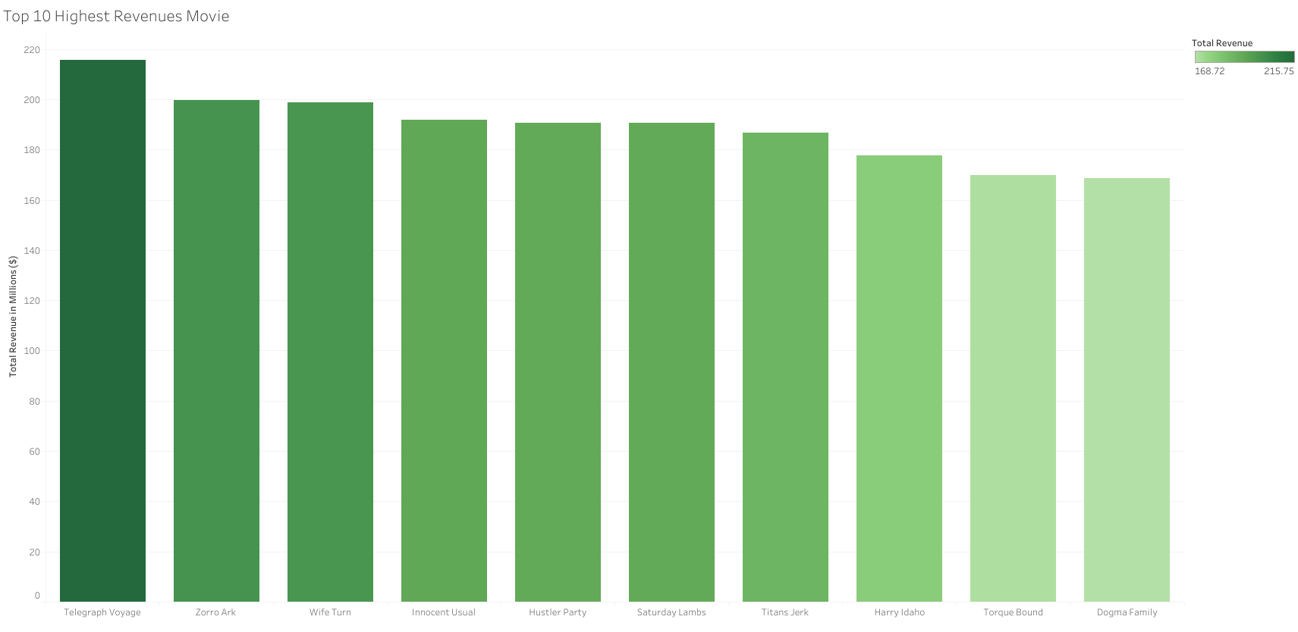
Top 10 Highest revenues movies
The highest-grossing movie is "Telegraph Voyage" with a total revenue of $215.75 million, while the lowest-grossing movie from the top 10 is "Dogma Family" with a revenue of $168.72 million

Slide 5
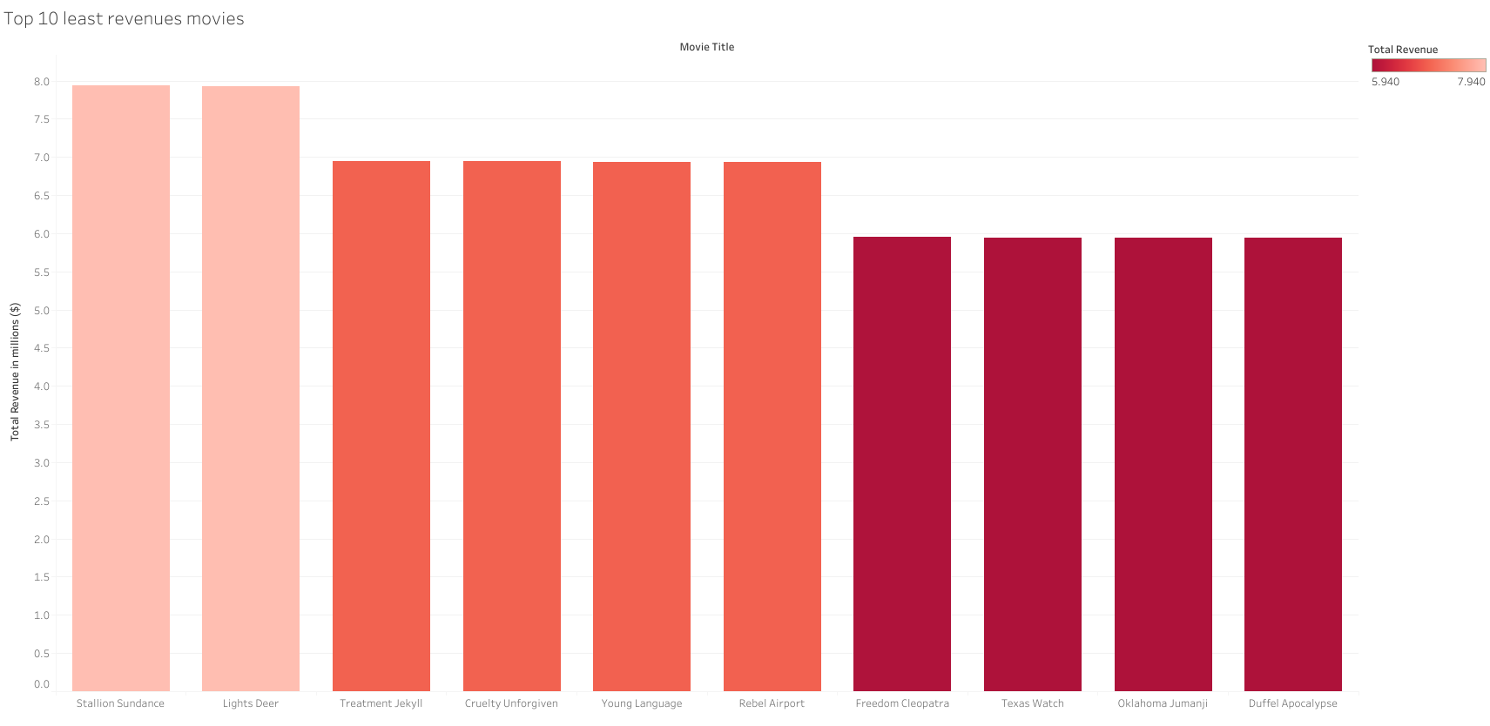
Top 10 Lowest revenues movies
The lowest revenue movies in the table are "Texas Watch," "Oklahoma Jumanji," and "Duffel Apocalypse," each earning $5.94 million.

Slide 6
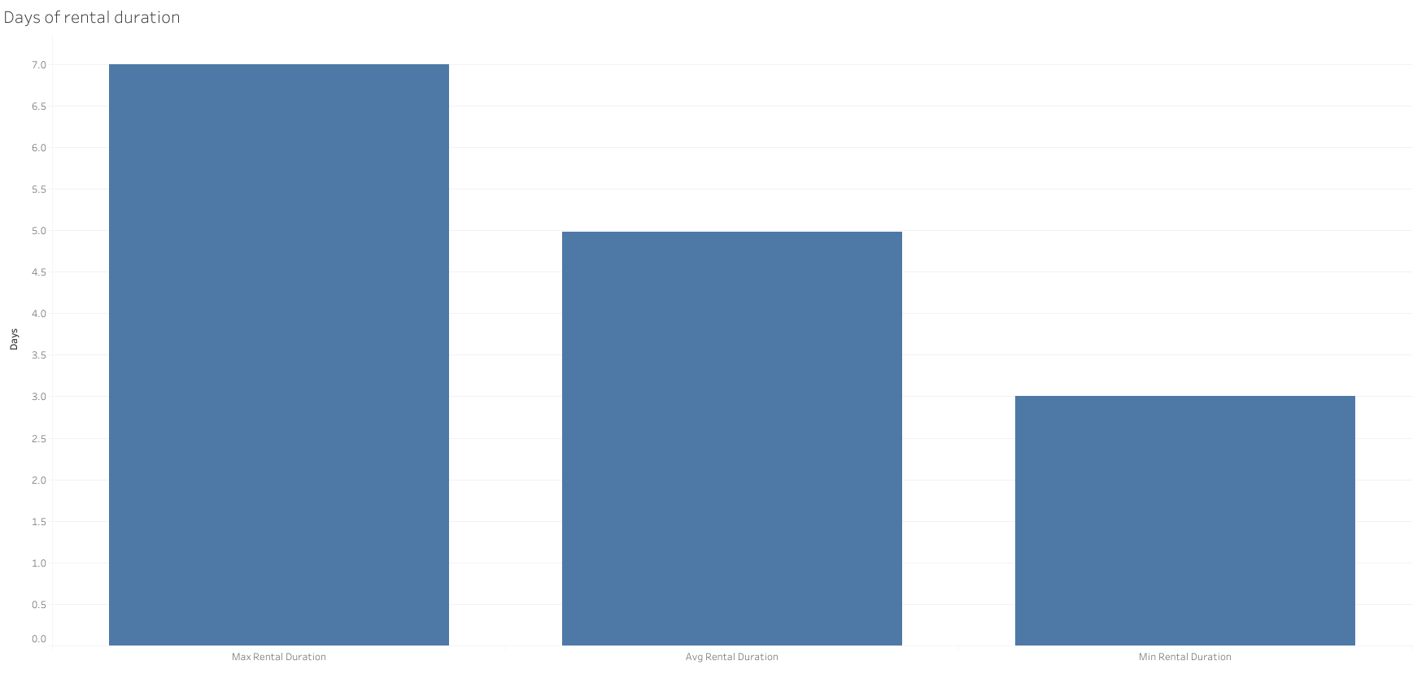
Days of Rental duration
The table displays rental duration data, showing a minimum rental duration of 3 days, a maximum rental duration of 7 days, and an average rental duration of approximately 5 days.

Slide 7
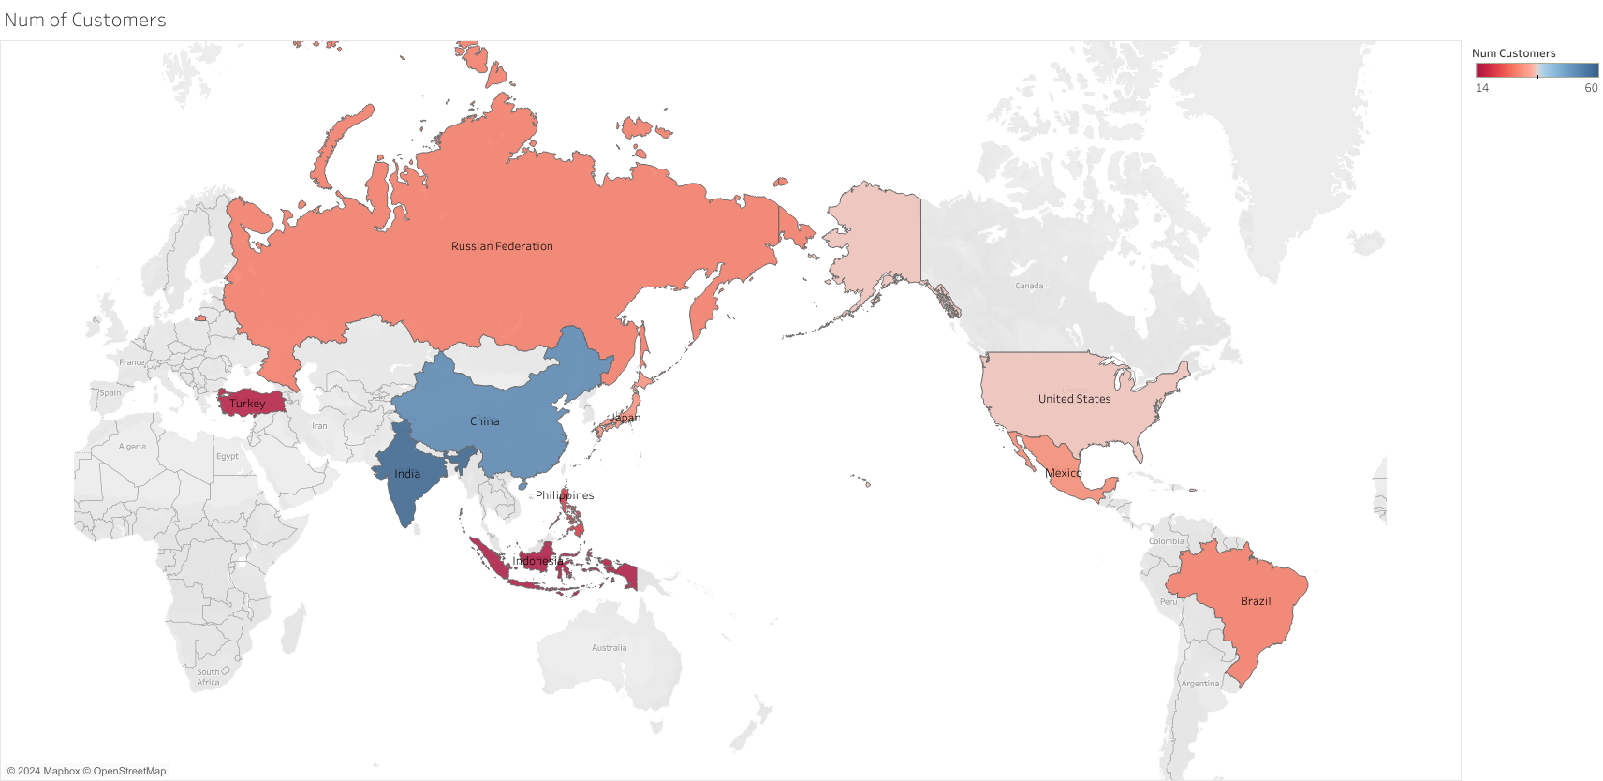
Customer Distribution by Country
India leads in customer count, followed closely by China.
The top three countries account for a significant proportion of total customers.

Slide 8
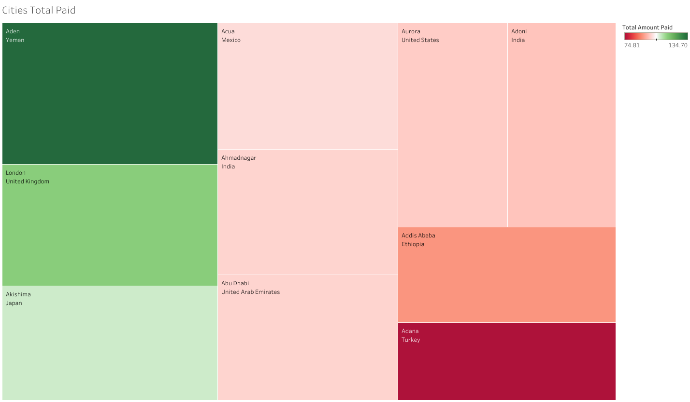
Total Amount Paid by City
Aden, Yemen has the highest total amount paid, surpassing other cities.
A diverse range of cities from different countries are represented, with significant payments in both developed and developing nations.

Slide 9
Conclusion
Rockbuster Stealth LLC is embarking on a significant transformation to stay competitive in the evolving entertainment landscape. Here are the key insights derived from our data analysis:
Top Revenue-Generating Movies:
"Telegraph Voyage" and "Zorro Ark" contributed the most to our revenue, while "Texas Watch" and "Oklahoma Jumanji" were among the least profitable.
Average Rental Duration:
The average rental duration across all videos is approximately 5 days, with a range from 3 to 7 days, indicating a consistent rental pattern among our customers.
Customer Distribution by Country:
Our customer base is predominantly from India, China, and the United States, highlighting these as key markets for our new online rental service.
High Lifetime Value Customers:
Cities such as Aden (Yemen), London (UK), and Akishima (Japan) have the highest total amount paid, suggesting they house customers with a high lifetime value.
Geographic Sales Variations:
Sales figures show significant regional variation, with some cities like Aden and London generating substantially higher revenue than others.

